Slide 1
Functions Returning a Value
ICS 3U0

Slide 2
Today’s Agenda
Over the past couple of days, we have learned how to write functions with or without parameters
Today, we will learn how to create functions that also return a value – called fruitful functions

Slide 3
Void Functions
def happy():
print("Happy birthday to you!")
def sing(name):
happy()
happy()
print("Happy birthday, dear", name + "!")
happy()
The two functions above are examples of void functions
Void functions can have parameters defined (the sing function) or not (the happy function)
All of the functions you have written so far have been void functions
Void functions are called "void" because they do not pass information back to the main program – fruitful functions do this

Slide 4
Fruitful Functions – Example
import random
num = random.randint(1,10)
print(num)
As we have learned, the randint function does not display the value of the randomly-selected integer
Instead, randint selects a random integer and returns its value to the main program
We then catch that value and assign it to the variable called num
randint is an example of a fruitful function

Slide 5
Fruitful Functions
Fruitful functions are defined just like void functions – the only difference is that fruitful functions return a value back to the main program
To return a value from a function that you create, we use the return keyword
The basic syntax is something like this:
def nameoffunction (parameters):
body of function
return value1, value2, …

Slide 6
Example – Return Difference
Write a function that takes two numbers as parameters and returns the difference of two numbers to the main program. Test your function in the main program with the numbers 7 and 2.
def find_difference(num1, num2):
difference = num1 - num2
return difference
# Main program
d =
print(d)
This code is now run with num1=7 and num2=2. The difference is found and returned to the main program.
The value returned is now saved in the variable called d. That is, d has been assigned the returned value which is 5.
The function is called and two arguments, num1 and num2, are passed in with values 7 and 2 respectively.
find_difference(7, 2)

Slide 7
Example – Even or Odd?
Write a function that takes a number as a parameter and determines if it is even or odd. Return True if even and False if odd. Test your function in the main program with the numbers 13 and 22.
def is_even(num):
if num % 2 == 0:
return True
else:
return False
# Main program
result = is_even(13)
print(result)
print(is_even(22))
We now have two different ways of printing values returned from a function

Slide 8
Functions – return keyword
When the return keyword is read, the function returns to the point where it was called immediately. Any code after the return statement will not be executed.
For instance, in the code below, nothing is ever printed to the screen because the print statement follows the return.
def add_num(num1, num2):
sum = num1 + num2
return sum
print("The sum is", sum)
# Main program
s = add_num(3, 5)
This code prints NO output. Need to move print statement above the return
Where else could we move it?

Slide 9
Exercises – Fruitful Functions
Complete Exercise 4.2 – Day 1

Slide 10
Functions that Return Multiple Values
A function can return more than one value by listing them after the return statement.
def sum_product(num1, num2):
sum = num1 + num2
product = num1 * num2
return sum, product
# Main program
s, p = sum_product(3, 5)
print(s, p)
Return two values back to the main program
Need to make sure that you use the same number of variables to store the results

Slide 11
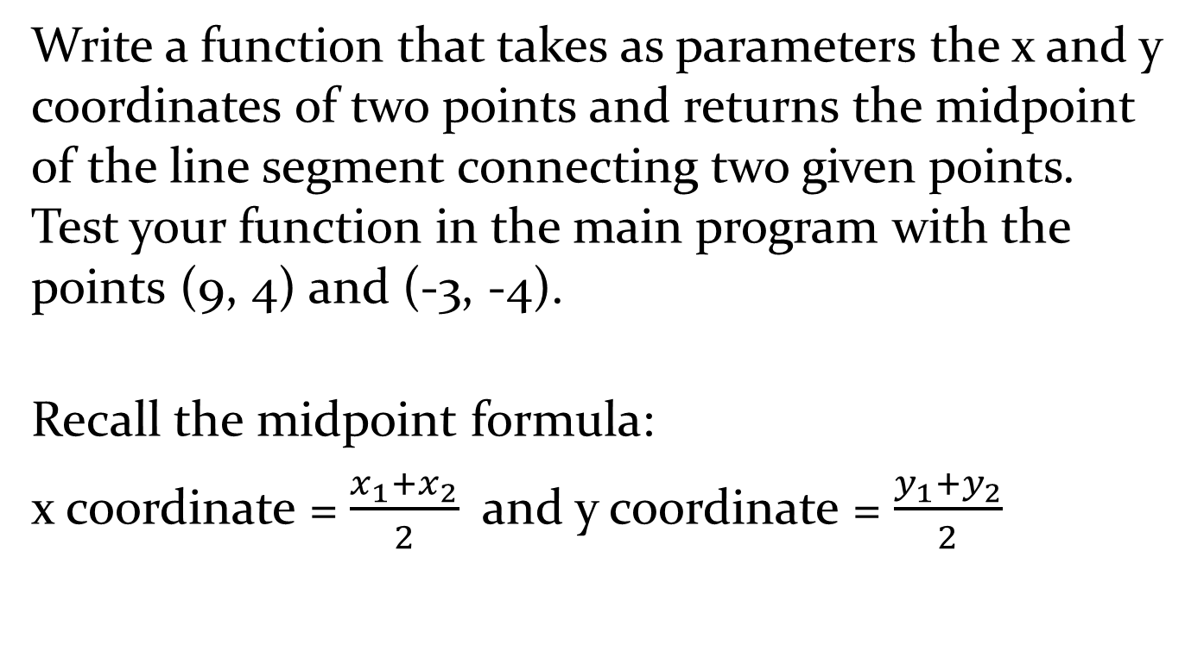
Example - Midpoint
Write a function that takes as parameters the x and y coordinates of two points and returns the midpoint of the line segment connecting two given points. Test your function in the main program with the points (9, 4) and (-3, -4).
Recall the midpoint formula:
x coordinate = $\frac{x_{1}+x_{2}}{2}$ and y coordinate = $\frac{y_{1}+y_{2}}{2}$

Slide 12
Example - Solution
def midpoint(x1, y1, x2, y2):
midx = (x1+x2)/2
midy = (y1+y2)/2
return midx, midy
# Main program
x, y = midpoint(9, 4, -3, -4)
print("The midpoint is (" + str(x) + "," + str(y) +").")

Slide 13
Let's Talk About Variables
Not sure if you noticed, but every single example that has been given in class and every single solution in homework used different variable names in the function and main program.
Let's take a look ….
I wanted to give you the correct impression that functions are like black boxes. Variables INSIDE the functions are not accessible OUTSIDE the functions.

Slide 14
Local Variables
When you create a variable inside a function, it is local or temporary, which means that it only exists inside the function. For example:
def cat_twice(part1, part2):
cat = part1 + part2
print(cat)
cat_twice("Foo", "bar")
print(cat)
When cat_twice terminates, the variable cat is destroyed. If we try to print it in the main program, we will get an error.

Slide 15
Global Variables
Consider the following example:
def cat_twice(part1, part2):
cat = part1 + part2 + part3
print_twice(cat)
part3 = "hello"
cat_twice("So", "what")
The variable part3 is created outside the function, so it belongs to the special frame called __main__. Variables in __main__ are sometimes called global because they can be accessed from any function. Unlike local variables, which disappear when their function ends, global variables persist from one function call to the next.

Slide 16
Example – Difference Between Global and Local Variables
In the example below, the function can access both the global and the local variable. However, trying to access the local variable outside the function produces an error.
def ex1():
local_var = 'bar'
print(global_var)
print(local_var)
global_var = 'foo'
ex1()
print(global_var)
print(local_var)
This executes the code inside the function and prints both the global_var and local_var.
This prints the value of the global_var
This produces an error, local_var is not available outside the function

Slide 17

Variable Scope
What's the take away from all this?
Be careful with variables!
The best and easiest and cleanest way to program is to use different variable names inside the main program and your functions. You will never, ever, ever run into difficulties if you program like this!
Scope is the part of the code where a variable name can be accessed. In Python:
The scope of a local variable is the body of the function that defines the local variable.
The scope of a global variable is the main program including all functions defined in the program.

Slide 18
Exercises Functions that Return Multiple Values
Complete Exercise 4.2 – Day 2

Slide 19
Something to Think About
Functions can be called from anywhere inside of a Python program – including inside another function

Slide 20
Functions Inside Functions Calculating SA and V of a Cylinder
import math
def areaRectangle(length, width):
return length * width
def areaCircle(radius):
return math.pi * radius**2
def circumference(radius):
return 2 * math.pi * radius
def surfaceAreaCylinder(radius, height):
return 2 * areaCircle(radius) + areaRectangle(circumference(radius), height)
### Program starts here
radius = int(input("Radius: "))
height = int(input("Height: "))
SA = surfaceAreaCylinder(radius, height)
print("The surface area of the cylinder is", SA)
Three typical functions to deal with the basic calculations required
This function calls the other three functions since they are used in the calculation of the SA

